Slide 1
Roadmap
Last week, we talked about how IR light can make covalent molecules vibrate and bend. That really means stretching and distorting the bonds between the atoms.
This week, we’ll talk about how ordinary molecular collisions can’t break covalent bonds, but how uv light can.
We’ll also need to talk a bit about what covalent bonds are like.

Slide 2
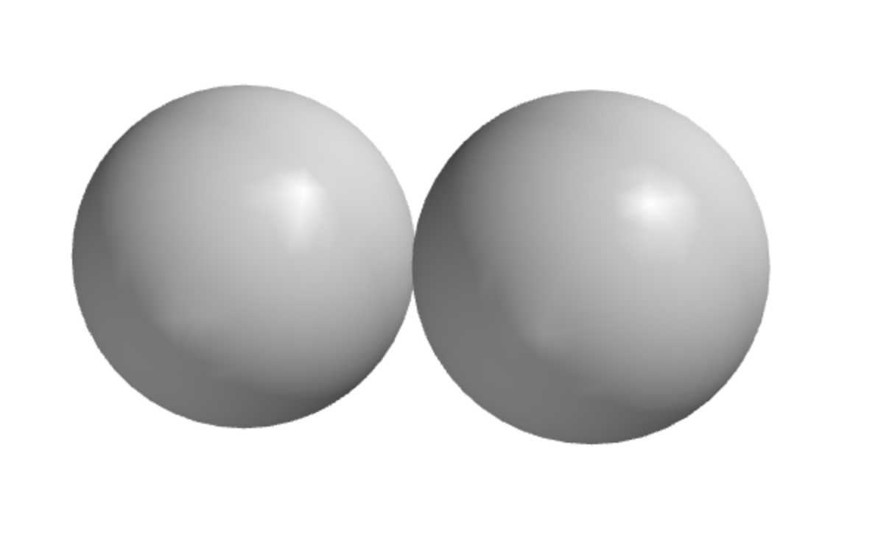
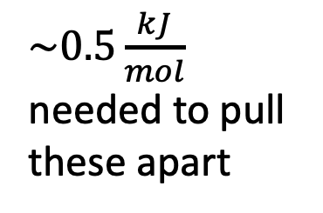
Covalent bonding is much stronger than molecular stickiness
Two H-atoms bonded by molecular stickiness
$\sim 0.5\frac{kJ}{mol}$ needed to pull these apart
Space-filling model, so these are the “van der Waals” sizes

Slide 3
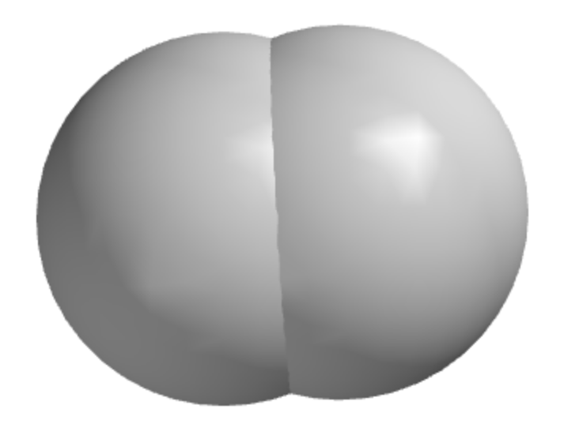
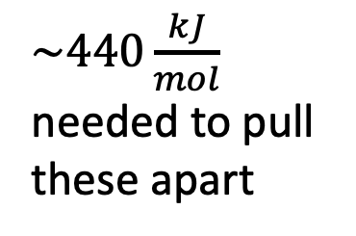
Covalent bonding is much stronger than molecular stickiness
Two H-atoms bonded by a covalent bond
$\sim 440\frac{kJ}{mol}$ needed to pull these apart
Space-filling model, so these are the “van der Waals” sizes

Slide 4

Also, atoms are much closer together when they’re covalently bonded
Two H-atoms bonded by molecular stickiness
$\sim 0.5\frac{kJ}{mol}$ needed to pull these apart
$$2.5 Å$$
Space-filling model, so these are the “van der Waals” sizes

Slide 5

Also, atoms are much closer together when they’re covalently bonded
Two H-atoms bonded by a covalent bond
$\sim 440\frac{kJ}{mol}$ needed to pull these apart
$$0.7 Å$$
Space-filling model, so these are the “van der Waals” sizes

Slide 6
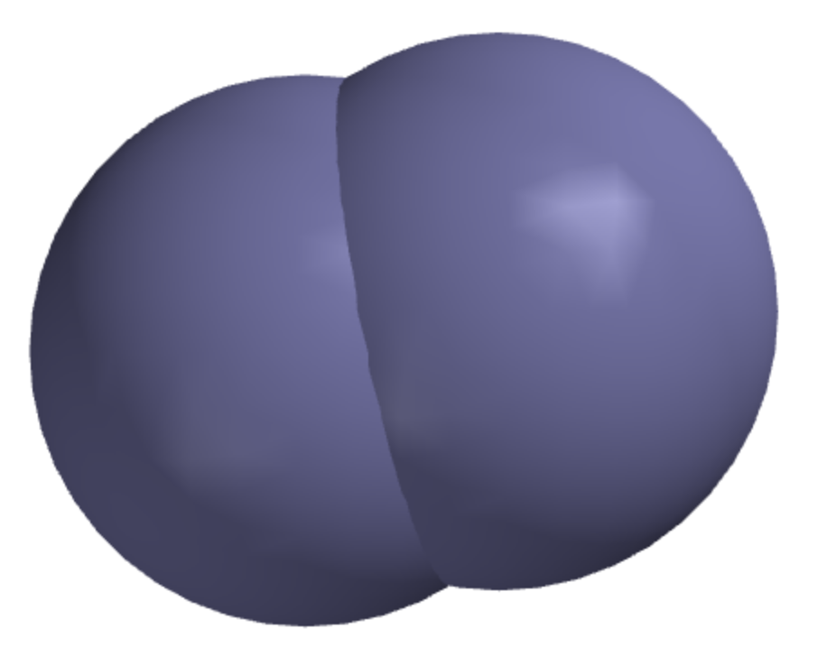
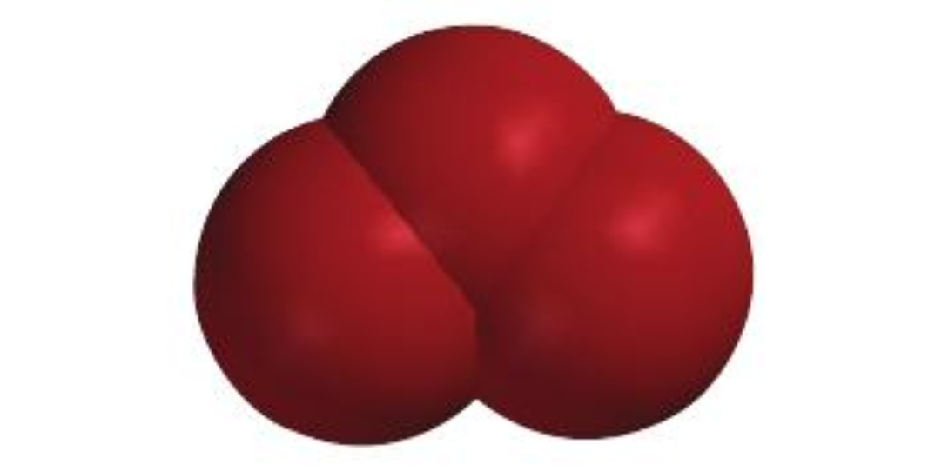
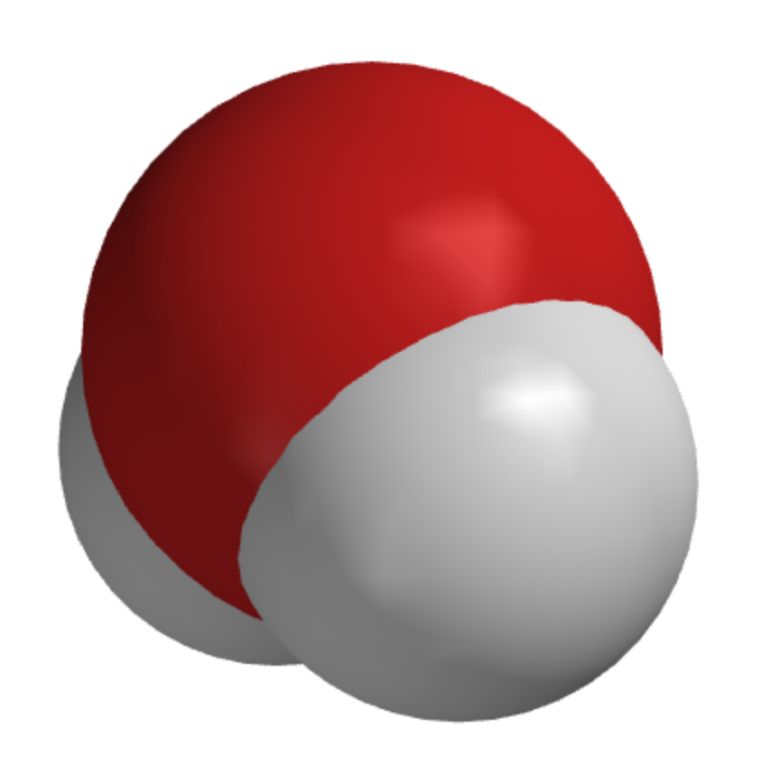
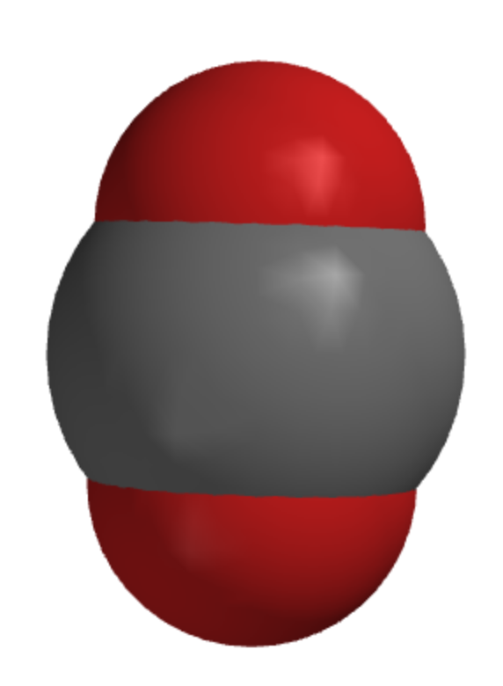
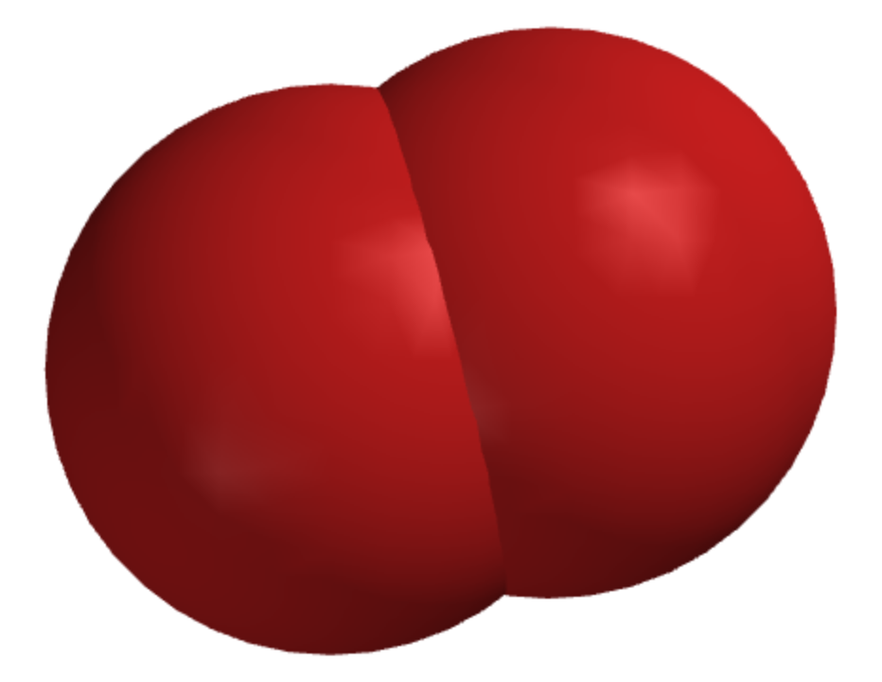
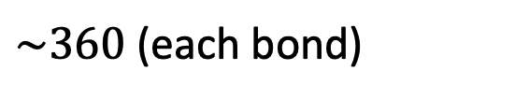

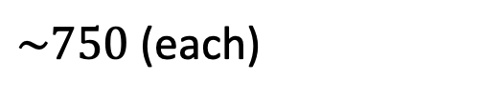

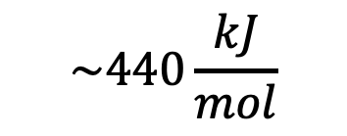
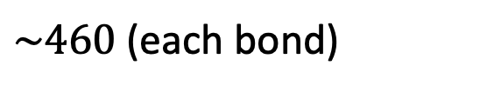
Atmospheric molecules have covalent bond strengths in the 100s (kJ/mol)
$$\sim 440\frac{kJ}{mol}$$
N₂O
H₂
N₂
$\sim 460$ (each bond)
O₃
(ozone)
$$\sim 950$$
H₂O
N₂
$\sim 360$ (each bond)
CO₂
$\sim 750$(each)
$$\sim 500$$
O₂

Slide 7
By comparison, the kinetic energy of random motion is $\sim 4\frac{kJ}{mol}$
Arrows show random motion of air molecules

Slide 8
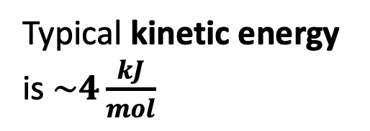
What happens when molecules collide?
Typical kinetic energy is $\sim 4\frac{kJ}{mol}$

Slide 9
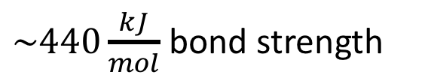
No way a collision with N₂ or O₂ will separate these H atoms
$\sim 440\frac{kJ}{mol}$ bond strength
Typical kinetic energy is $\sim 4\frac{kJ}{mol}$

Slide 10
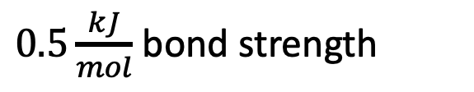
Even a single collision (with N₂ or O₂) will separate these H atoms
$0.5\frac{kJ}{mol}$ bond strength
Typical kinetic energy is $\sim 4\frac{kJ}{mol}$

Slide 11
=> Atmospheric molecules don’t break apart due to collisions
$$\sim 440\frac{kJ}{mol}$$
N₂O
H₂
N₂
$\sim 460$ (each bond)
O₃
(ozone)
$$\sim 950$$
H₂O
N₂
$\sim 360$ (each bond)
CO₂
$\sim 750$(each)
$$\sim 500$$
O₂
https://opentextbc.ca/chemistry/chapter/7-5-strengths-of-ionic-and-covalent-bonds/

Slide 12
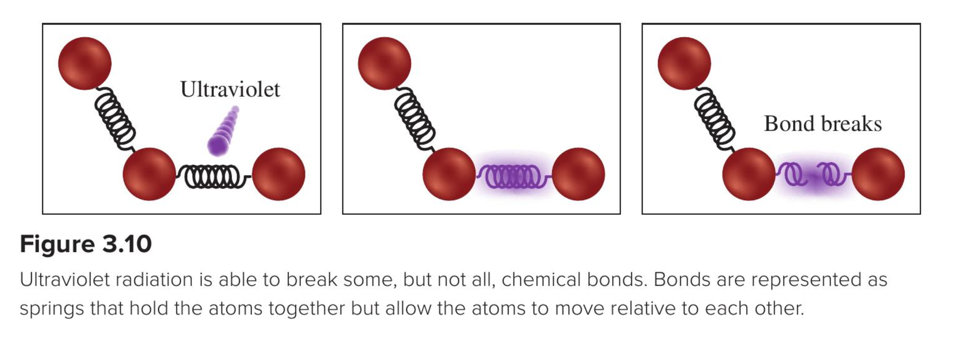
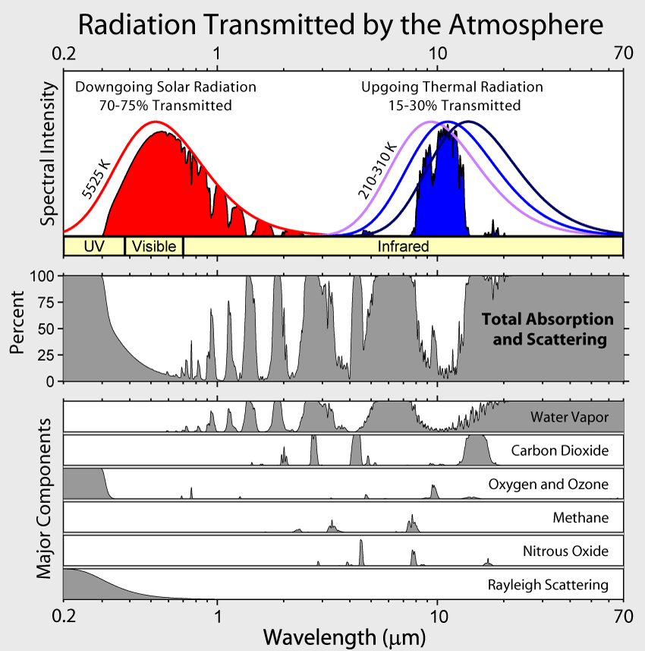
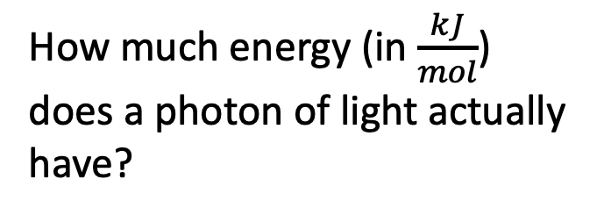
But some kinds of light can break covalent bonds!
How much energy (in $\frac{kJ}{mol}$) does a photon of light actually have?

Slide 13
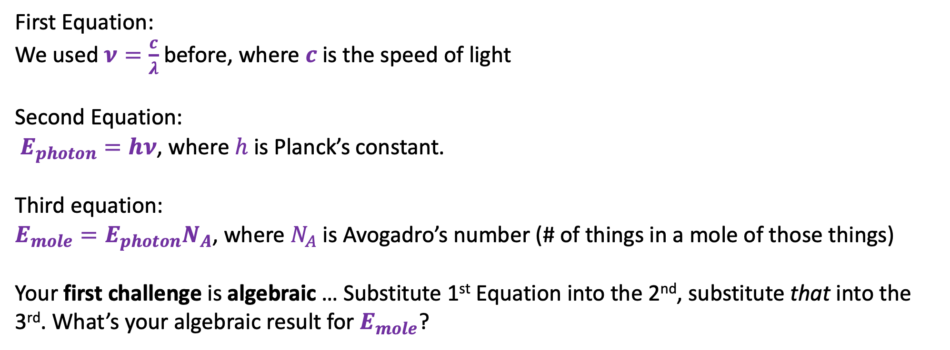
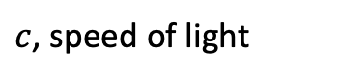
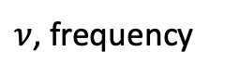
Breaking bonds - the algebraic challenge
$c$, speed of light
$ν$, frequency
First Equation:
We used $ν=\frac{c}{λ}$ before, where $c$ is the speed of light
Second Equation:
$E_{photon}=hν$, where $h$ is Planck’s constant.
Third equation:
$E_{mole}=E_{photon}N_{A}$, where $N_{A}$ is Avogadro’s number (# of things in a mole of those things)
Your first challenge is algebraic … Substitute 1st Equation into the 2nd, substitute that into the 3rd. What’s your algebraic result for $E_{mole}$?

Slide 14
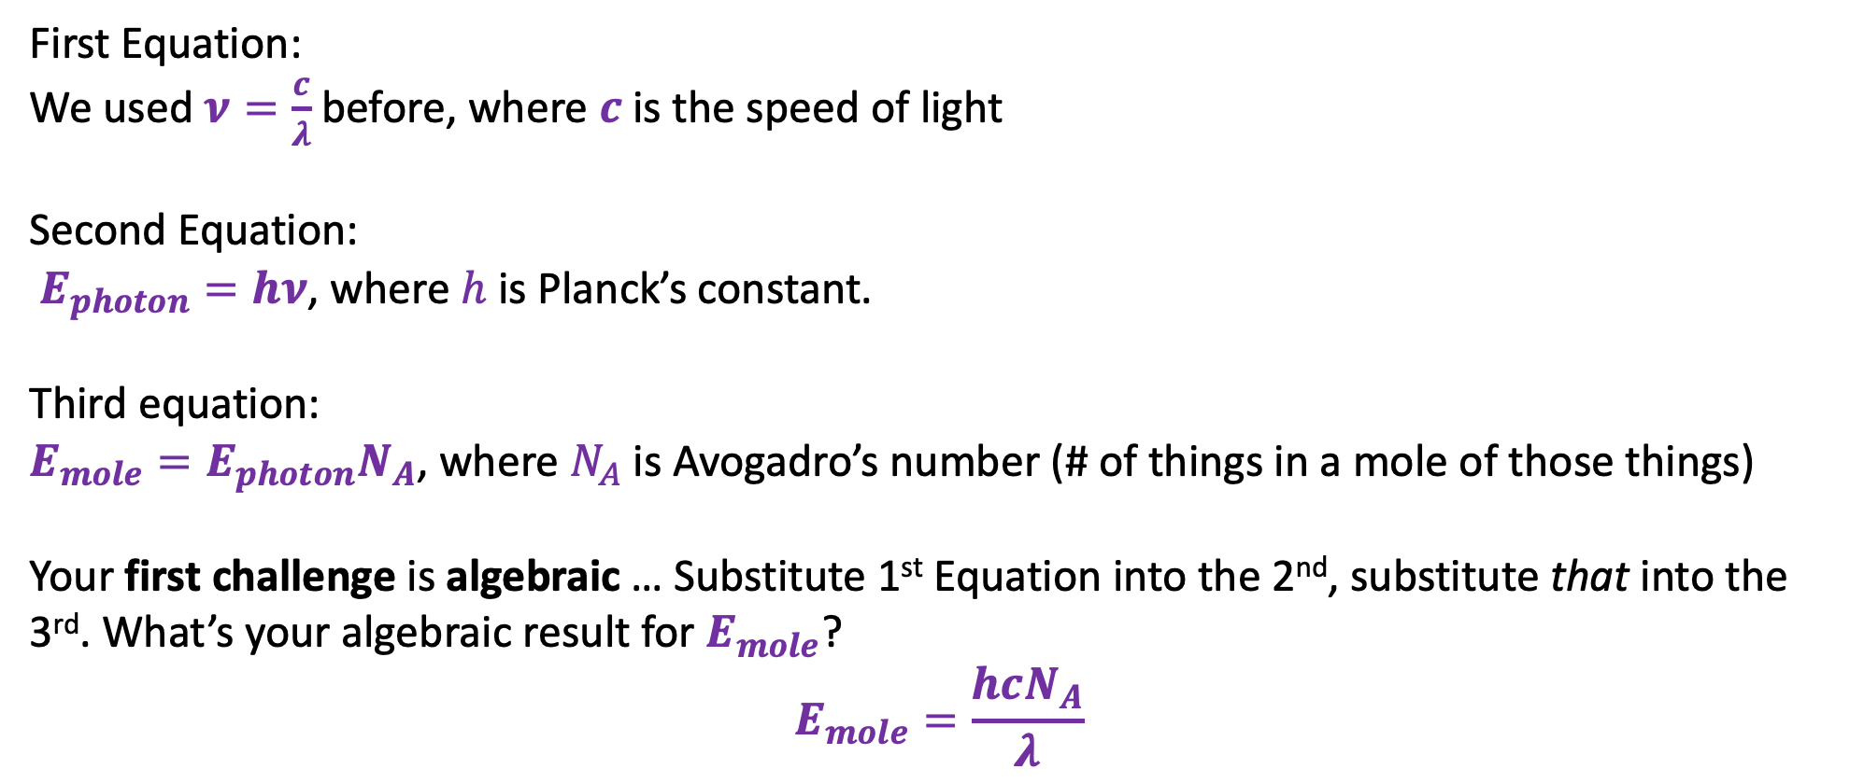
Breaking bonds - the algebraic challenge
$c$, speed of light
$ν$, frequency
First Equation:
We used $ν=\frac{c}{λ}$ before, where $c$ is the speed of light
Second Equation:
$E_{photon}=hν$, where $h$ is Planck’s constant.
Third equation:
$E_{mole}=E_{photon}N_{A}$, where $N_{A}$ is Avogadro’s number (# of things in a mole of those things)
Your first challenge is algebraic … Substitute 1st Equation into the 2nd, substitute that into the 3rd. What’s your algebraic result for $E_{mole}$?
$$E_{mole}=\frac{hcN_{A}}{λ}$$

Slide 15
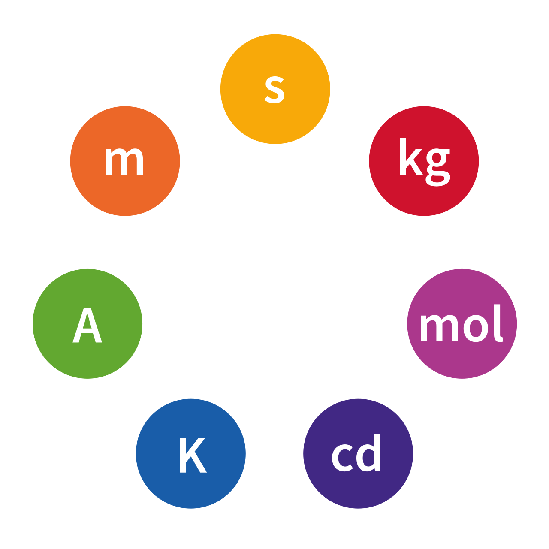
Breaking bonds - the unit challenge
$c$, speed of light
$ν$, frequency
Your next challenge has to do with the SI units of $E_{mole}=\frac{hcN_{A}}{λ}$. What’s SI?
These are called the SI base units:
Meters
Seconds
Kilograms
Degrees
Moles
https://en.wikipedia.org/wiki/SI_base_unit#/media/File:SI_base_units.svg

Slide 16
Breaking bonds - the unit challenge
$c$, speed of light
$ν$, frequency
Your next challenge has to do with the SI units of $E_{mole}=\frac{hcN_{A}}{λ}$. What’s SI?
These are called the SI base units:
Derived unit we need to know about:
Joules (unit of energy):
1 J = kg⋅m²⋅s⁻²
Meters
Seconds
Kilograms
Degrees
Moles
(Write all these down)

Slide 17
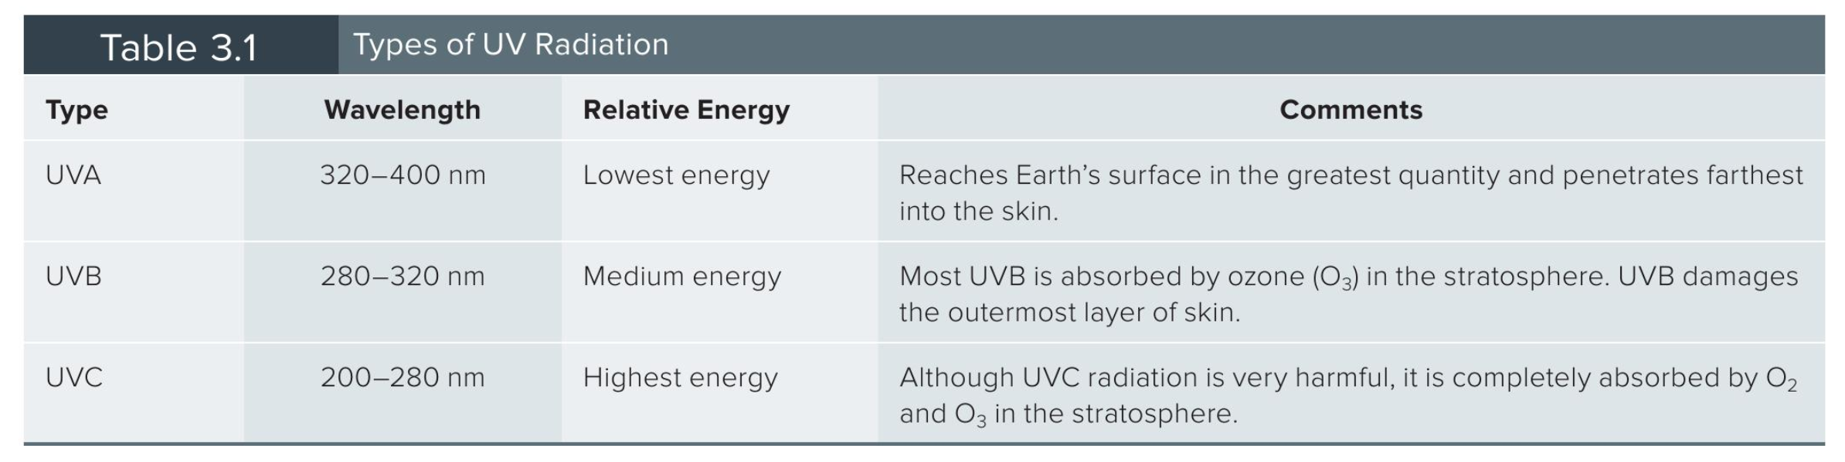
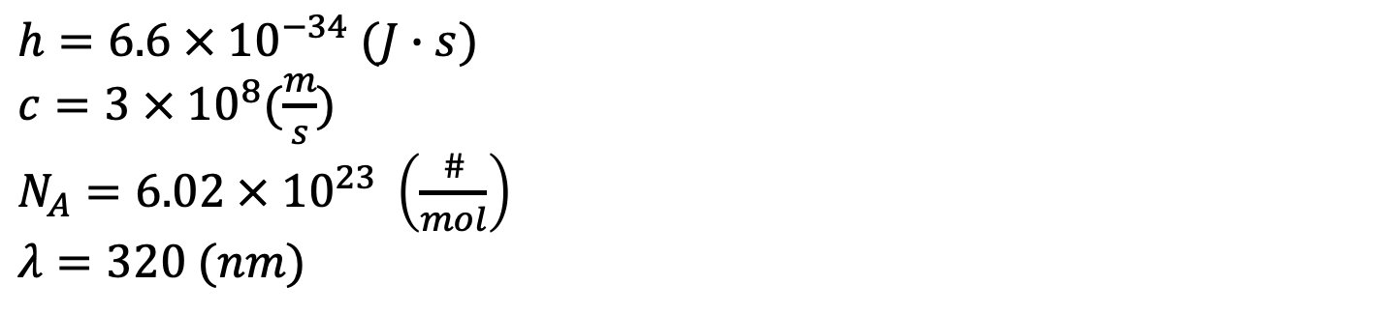
Breaking bonds - the unit challenge
$c$, speed of light
$ν$, frequency
Your next challenge has to do with identifying all the quantities in $E_{mole}=\frac{hcN_{A}}{λ}$ as SI or not SI (and fixing if the latter).
$h=6.6 × {10}^{−34} (J∙s)$
$c=3 × {10}^{8}(\frac{m}{s})$
$N_{A}=6.02 × {10}^{23} \left(\frac{\#}{mol}\right)$
$λ=320 (nm)$

Slide 18
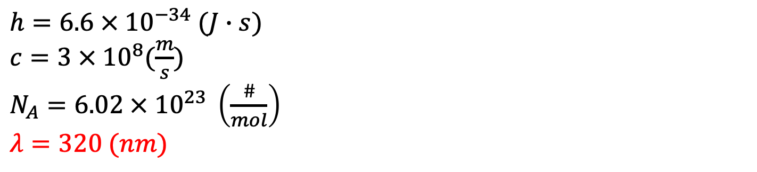
Breaking bonds - the unit challenge
$c$, speed of light
$ν$, frequency
Your next challenge has to do with identifying all the quantities in $E_{mole}=\frac{hcN_{A}}{λ}$ as SI or not SI (and fixing if the latter).
$h=6.6 × {10}^{−34} (J∙s)$
$c=3 × {10}^{8}(\frac{m}{s})$
$N_{A}=6.02 × {10}^{23} \left(\frac{\#}{mol}\right)$
$λ=320 (nm)$

Slide 19
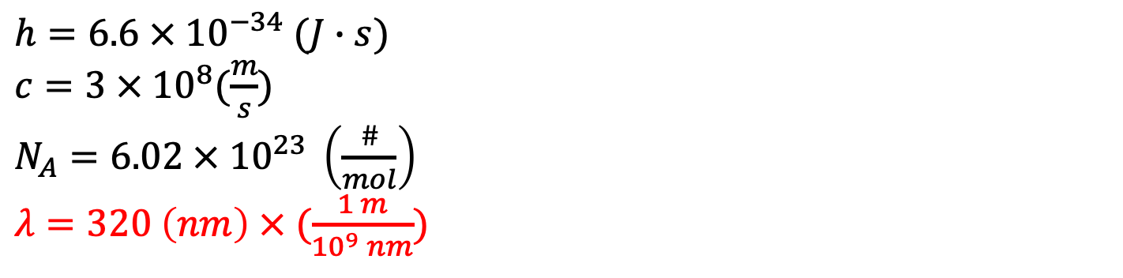
Breaking bonds - the unit challenge
$c$, speed of light
$ν$, frequency
Your next challenge has to do with identifying all the quantities in $E_{mole}=\frac{hcN_{A}}{λ}$ as SI or not SI (and fixing if the latter).
$h=6.6 × {10}^{−34} (J∙s)$
$c=3 × {10}^{8}(\frac{m}{s})$
$N_{A}=6.02 × {10}^{23} \left(\frac{\#}{mol}\right)$
$λ=320 \left(nm\right) × (\frac{1 m}{{10}^{9} nm})$

Slide 20
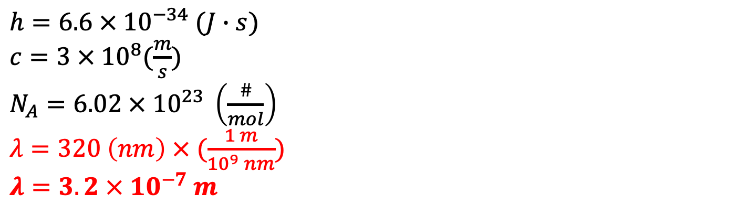
Breaking bonds - the unit challenge
$c$, speed of light
$ν$, frequency
Your next challenge has to do with identifying all the quantities in $E_{mole}=\frac{hcN_{A}}{λ}$ as SI or not SI (and fixing if the latter).
$h=6.6 × {10}^{−34} (J∙s)$
$c=3 × {10}^{8}(\frac{m}{s})$
$N_{A}=6.02 × {10}^{23} \left(\frac{\#}{mol}\right)$
$λ=320 \left(nm\right) × (\frac{1 m}{{10}^{9} nm})$
$λ=3.2 × {10}^{−7} m$

Slide 21
Breaking bonds - the unit challenge
$c$, speed of light
$ν$, frequency
Your next challenge has to do with identifying all the quantities in $E_{mole}=\frac{hcN_{A}}{λ}$ as SI or not SI (and fixing if the latter).
$h=6.6 × {10}^{−34} (J∙s)$
$c=3 × {10}^{8}(\frac{m}{s})$
$N_{A}=6.02 × {10}^{23} \left(\frac{\#}{mol}\right)$
$λ=320 \left(nm\right) × (\frac{1 m}{{10}^{9} nm})$
$λ=3.2 × {10}^{−7} m$

Slide 22
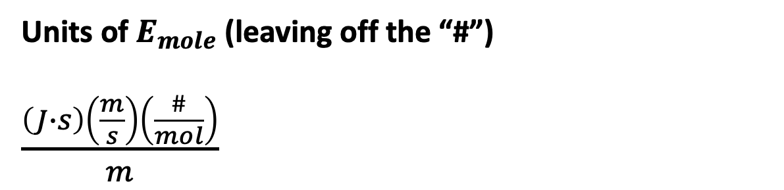
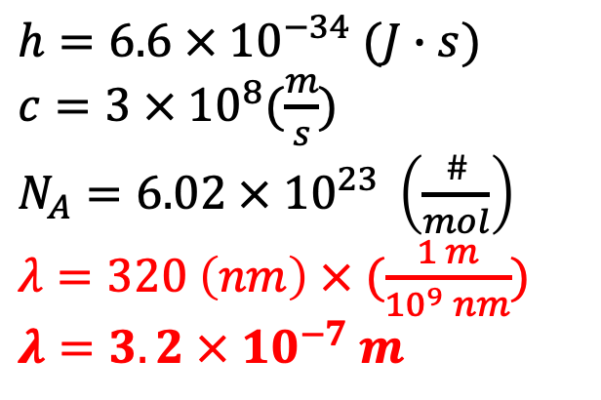
Breaking bonds - the unit challenge
$c$, speed of light
$ν$, frequency
Your next challenge has to do with identifying all the quantities in $E_{mole}=\frac{hcN_{A}}{λ}$ as SI or not SI (and fixing if the latter).
$h=6.6 × {10}^{−34} (J∙s)$
$c=3 × {10}^{8}(\frac{m}{s})$
$N_{A}=6.02 × {10}^{23} \left(\frac{\#}{mol}\right)$
$λ=320 \left(nm\right) × (\frac{1 m}{{10}^{9} nm})$
$λ=3.2 × {10}^{−7} m$
Units of $E_{mole}$ (leaving off the “#”)
$\frac{\left(J∙s\right)\left(\frac{m}{s}\right)\left(\frac{\#}{mol}\right)}{m}$

Slide 23
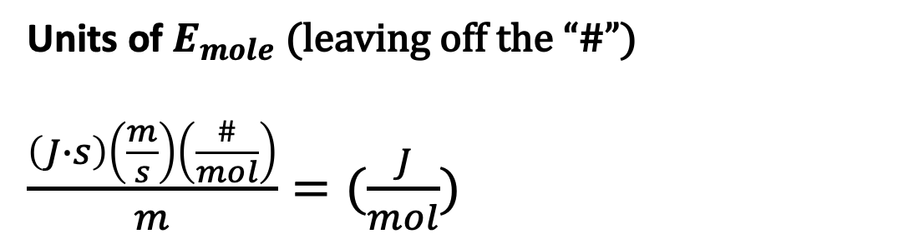
Breaking bonds - the unit challenge
$c$, speed of light
$ν$, frequency
Your next challenge has to do with identifying all the quantities in $E_{mole}=\frac{hcN_{A}}{λ}$ as SI or not SI (and fixing if the latter).
$h=6.6 × {10}^{−34} (J∙s)$
$c=3 × {10}^{8}(\frac{m}{s})$
$N_{A}=6.02 × {10}^{23} \left(\frac{\#}{mol}\right)$
$λ=320 \left(nm\right) × (\frac{1 m}{{10}^{9} nm})$
$λ=3.2 × {10}^{−7} m$
Units of $E_{mole}$ (leaving off the “#”)
$\frac{\left(J∙s\right)\left(\frac{m}{s}\right)\left(\frac{\#}{mol}\right)}{m}=(\frac{J}{mol})$

Slide 24
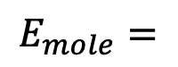
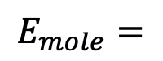
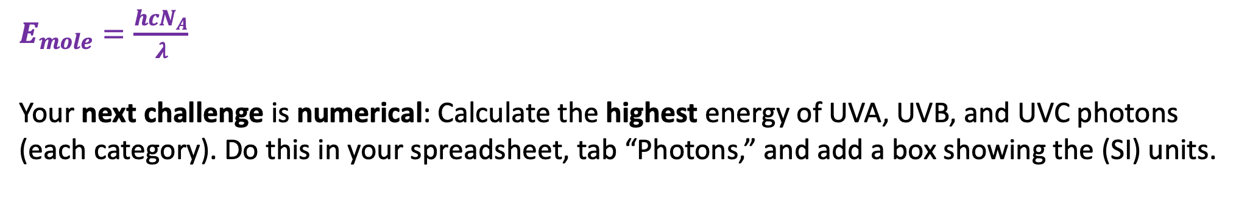
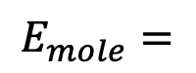
Numerical results for photon energies
$E_{mole}=\frac{hcN_{A}}{λ}$
Your next challenge is numerical: Calculate the highest energy of UVA, UVB, and UVC photons (each category). Do this in your spreadsheet, tab “Photons,” and add a box showing the (SI) units.
$$E_{mole}=$$
$$E_{mole}=$$
$$E_{mole}=$$

Slide 25
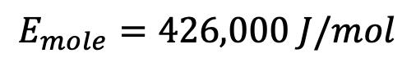
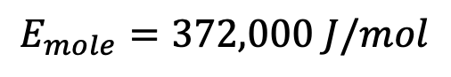
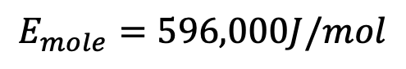
Numerical results for photon energies
$E_{mole}=\frac{hcN_{A}}{λ}$
Your next challenge is numerical: Calculate the highest energy of UVA, UVB, and UVC photons (each category). Do this in your spreadsheet, tab “Photons,” and add a box showing the (SI) units.
$$E_{mole}=372,000 J/mol$$
$$E_{mole}=426,000 J/mol$$
$$E_{mole}=596,000J/mol$$

Slide 26
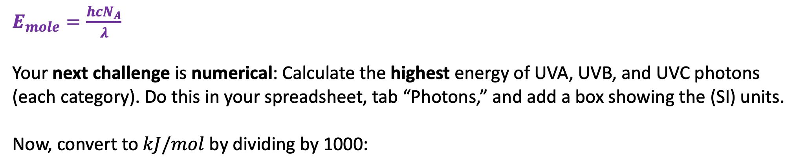
Numerical results for photon energies
$E_{mole}=\frac{hcN_{A}}{λ}$
Your next challenge is numerical: Calculate the highest energy of UVA, UVB, and UVC photons (each category). Do this in your spreadsheet, tab “Photons,” and add a box showing the (SI) units.
Now, convert to $kJ/mol$ by dividing by 1000:
$$E_{mole}=372,000 J/mol$$
$$E_{mole}=426,000 J/mol$$
$$E_{mole}=596,000J/mol$$

Slide 27
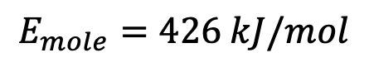
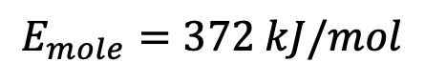
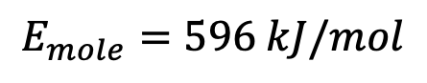
Numerical results for photon energies
$E_{mole}=\frac{hcN_{A}}{λ}$
Your next challenge is numerical: Calculate the highest energy of UVA, UVB, and UVC photons (each category). Do this in your spreadsheet, tab “Photons,” and add a box showing the (SI) units.
Now, convert to $kJ/mol$ by dividing by 1000:
$$E_{mole}=372 kJ/mol$$
$$E_{mole}=426 kJ/mol$$
$$E_{mole}=596 kJ/mol$$

Slide 28
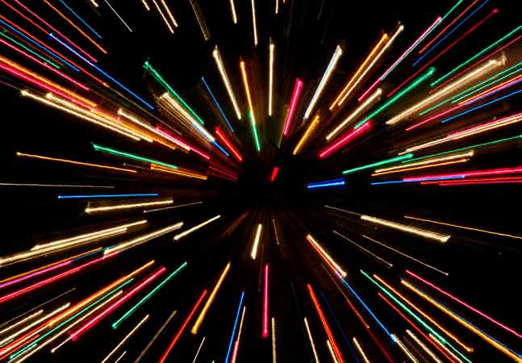
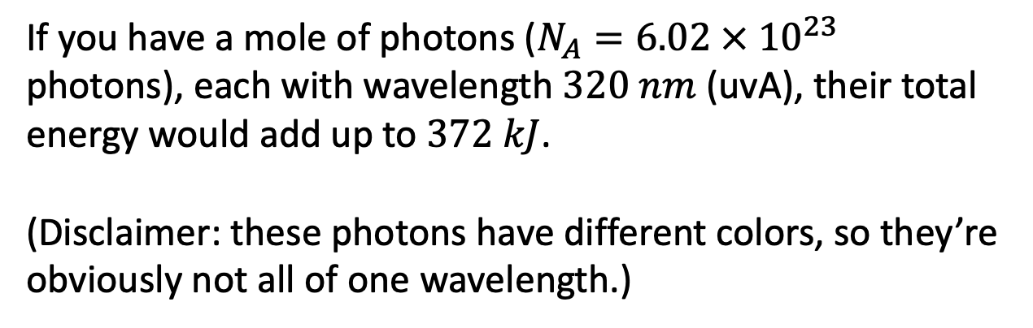
What the unit $\frac{kJ}{mol}$ means
If you have a mole of photons ($N_{A}=6.02 × {10}^{23}$ photons), each with wavelength $320 nm$ (uvA), their total energy would add up to $372 kJ$.
(Disclaimer: these photons have different colors, so they’re obviously not all of one wavelength.)
$$E_{mole}=372 kJ/mol$$
$$E_{mole}=426 kJ/mol$$
$$E_{mole}=596 kJ/mol$$

Slide 29
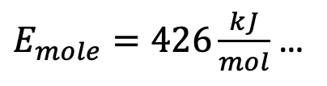
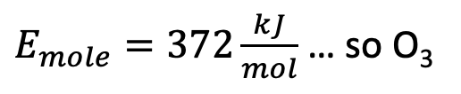
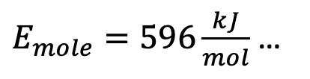
Putting this all together … what molecules can uv light break apart?
$E_{mole}=372\frac{kJ}{mol}$ … so O₃
$E_{mole}=426\frac{kJ}{mol}$ …
$E_{mole}=596\frac{kJ}{mol}$ …

Slide 30
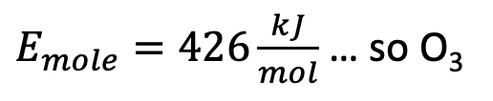
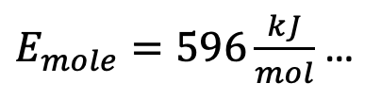
Putting this all together … what molecules can uv light break apart?
$E_{mole}=372\frac{kJ}{mol}$ … so O₃
$E_{mole}=426\frac{kJ}{mol}$ … so O₃
$E_{mole}=596\frac{kJ}{mol}$ …

Slide 31

Putting this all together … what molecules can uv light break apart?
$E_{mole}=372\frac{kJ}{mol}$ … so O₃
$E_{mole}=426\frac{kJ}{mol}$ … so O₃
$E_{mole}=596\frac{kJ}{mol}$ … so so O₃, O₂, H₂O, H₂

Slide 32
Handouts for today

Slide 33


SI units
A mole of anything is $6.02 × {10}^{23}$ of them. Sometimes we write this idea as
$N_{A}=6.02 × {10}^{23} (\frac{\#}{mol})$ or
$N_{A}=6.02 × {10}^{23} (mol^{−1})$
A bunch of photons
(if there were $N_{A}$ of these, it would be a mole of photons).
SI base units:
Meters
Seconds
Kilograms
Degrees
Moles
Derived unit we need to know about:
Joules (unit of energy):
1 J = kg⋅m²⋅s⁻²

Slide 34
Bond strengths of atmospheric molecules
$$\sim 440\frac{kJ}{mol}$$
N₂O
H₂
$\sim 460$ (each bond)
O₃
(ozone)
$$\sim 950$$
H₂O
N₂
$\sim 360$ (each bond)
CO₂
$\sim 750$(each)
$$\sim 500$$
O₂
https://opentextbc.ca/chemistry/chapter/7-5-strengths-of-ionic-and-covalent-bonds/

